Slide 1
34b – Clean Code – Iterator and Adapter Patterns
Based on the CleanCoders videos by Uncle Bob Martin
Rupert Waldron

Slide 2
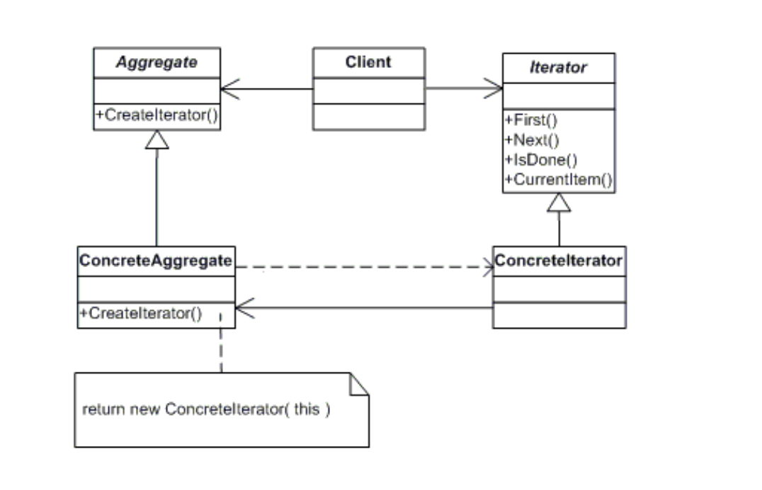
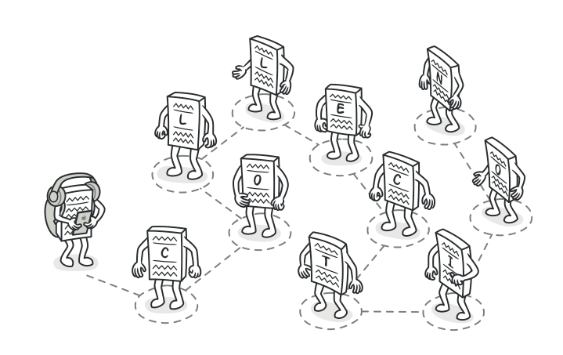
Iterator Pattern
Provide a way to access the elements of an aggregation object sequentially without exposing its underlying representation.

Slide 3
Iterator Pattern – What’s wrong with loops
Iterate over 25 integers and square the value
public static void main(String[] args) { for (int i = 0; i < 25; i++) { // the loop dominates the algorithm and determines the order of the numbers System.out.println(i * i); // calculation is hidden within the loop } }
By using an iterator we take the focus off the loop and on to the method of squaring

Slide 4
Iterator Pattern – Why create your own
The iterator enables you to take your data structure and provide elements in the order determined by you.
The iterator can generate the values in a lazy manner… they are created only when they are needed
Implement the Iterable interface and override the iterator method. This returns an iterator.
class GridIterator implements Iterable<Integer> {
@Override public Iterator<Integer> iterator() {
….
while (iterator.hasNext()) { System.out.println("Iteration = " + iterator.next()); }
Override the hasNext() and next() methods of the iterator and evaluate them like above
See the grid code

Slide 5
Iterator Pattern – Infinite values
You don’t need the Iterable interface, just make your own. Lets create something that looks like a java stream….
public class Integers implements RRIterator<Integer> { private int value; @Override public boolean hasNext() { return true; } @Override public Integer next() { System.out.println("Sending next value -> " + value); return value++; } }
RRStream.of(ints) .map(x -> x * x) .filter(x -> x % 2 == 0) .map(x -> -x) .limit(25) .forEach(System.out::println);
See the Stream code

Slide 6
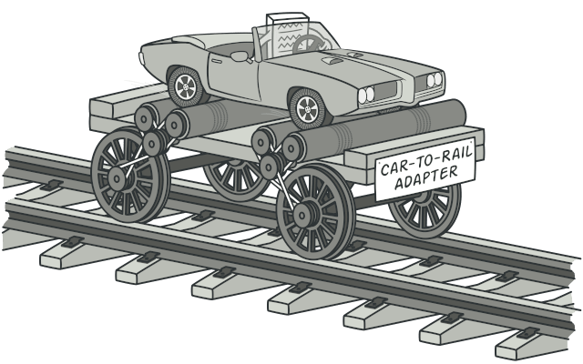
Adapter Pattern
Convert the interface of a class into another interface the clients expect. Adapter lets classes work together that couldn’t otherwise because of incompatible interfaces

Slide 7
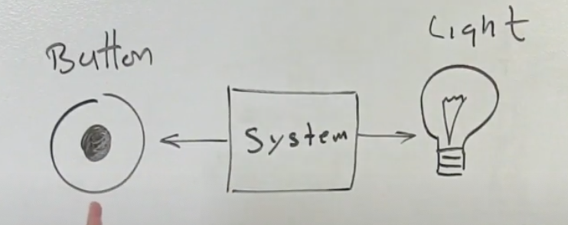
Adapter Pattern – Table Lamp Challenge
The Software/System can sense the state of the button. The software can control the state of the light
Design a that turns the light on when you push the button

Slide 8
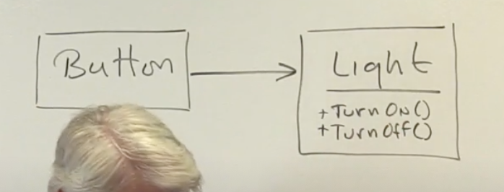
Adapter Pattern – Table Lamp Challenge
Which SOLID Principles does this violate?
It violates:
SRP – Button should only know about the button
OCP – Buttons can control more things than just lights.
DI – Light is a concrete class.

Slide 9
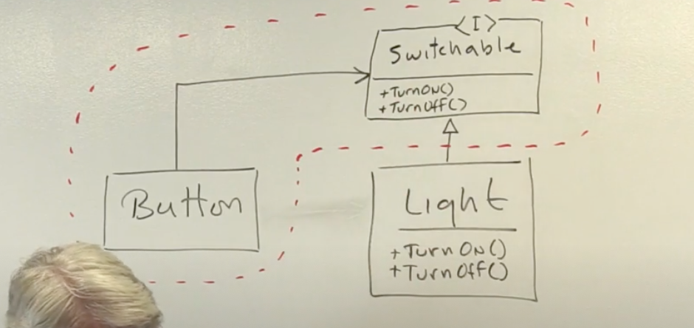
Adapter Pattern – Table Lamp Challenge
Solve this using an interface!!!
The relationship between the interface and its client is much stronger than the relationship between the interface and its implementation.
Interfaces are named by the services they offer to their clients.
Downside of above is an OCP violation, because if the light class already exists then we would have to modify it to implement the Switchable interface.

Slide 10
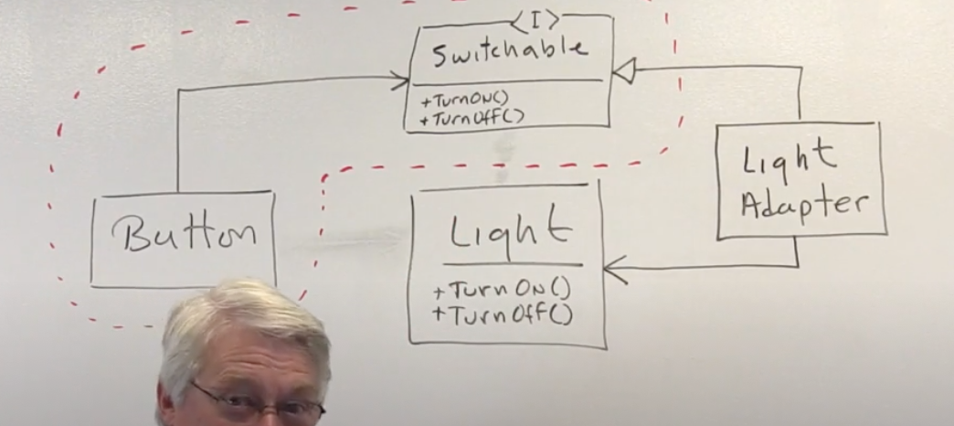
Adapter Pattern – Table Lamp Challenge
What if the Light class already exists?
What if the Light class is part of some 3rd party library?
Object Form of the Adapter Pattern – need whole new object
The LightAdapter will implement the interface and wrap the Light object
Neither the Button nor the Light know anything about the LightAdapter
The LightAdapter can change Lights using the setLight() method – lots of flexibility

Slide 11
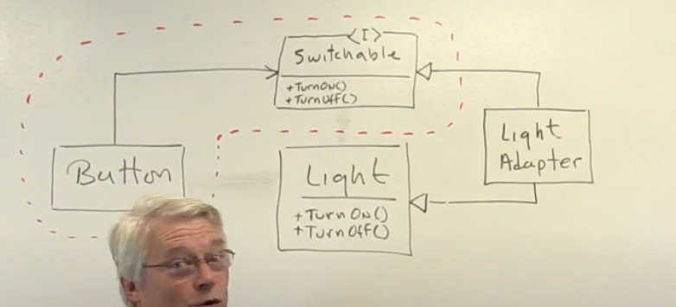
Adapter Pattern – Table Lamp Challenge
Class Form of the Adapter Pattern – uses a derivative
Simpler, but more rigid – you can’t change the type of light as you can with the Object form

